Slide 1

Product Management Module 1 – Office Hrs with Raunak Goyal Oct 08, 2023

Slide 2
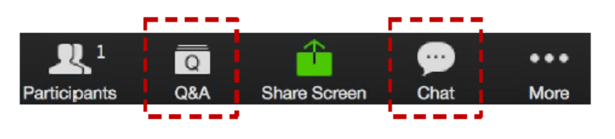
ZOOM: CHAT and Q&A BOX
Please enter your questions in the Q&A box. We’ll answer these in the Q&A and stop from time to time to bring these to the broader attention of the class
Please enter your response in the ‘Chat box.’ Before you send it, please make sure that your response goes to ‘All Panelists and Attendees’
Please type your questions in the QA
Also, ongoing discussion in the Chat
Notes:
Please enter your questions in the Q&A box. We’ll answer these in the Q&A and stop from time to time to bring these to the broader attention of the class
Please enter your response in the ‘Chat box.’ Before you send it, please make sure that your response goes to ‘All Panelists and Attendees’
Due to the size of the cohort we will not be able to unmute people to speak, though we may investigate doing that in later sessions.
Now for today’s agenda

Slide 3



AGENDA
Getting Help
Module Review
Assignment Discussions
Additional Resources
Programme Schedule
Next Week
Q&A
Notes:
In today’s session we will cover the following topics:
Getting Help
Module Review
Assignment Discussions
Additional Resources
Programme Schedule
Next Week
Q&A

Slide 4
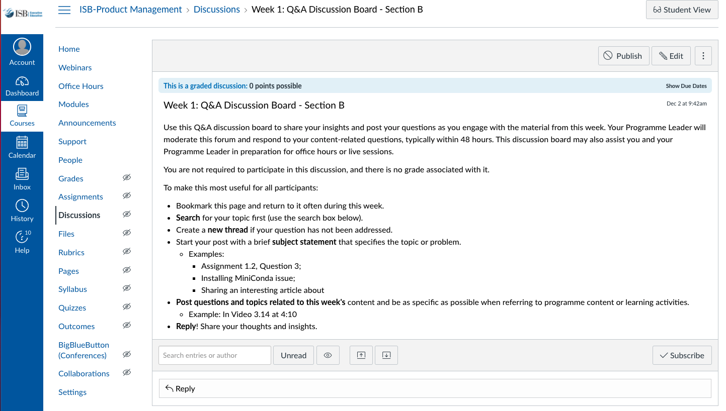
GETTING HELP
Notes:
One of the best resources are your classmates. A great way to learn from them is to engage on the weekly discussion topic. We want to broadly encourage collaboration, though without plagiarism. Share your thoughts, concepts, pluses and minuses though not your actual answers.
These are accessible in the weekly module, though I have highlighted the page where you will be taken.
It is great that many of you are setting up study groups via WhatsApp. We encourage that independent initiative and effort, while the programme leaders can not participate in those groups, we will engage in the group discussions on Canvas. What we will also do is provide some of the additional resources we reference in office hours in these discussions.

Slide 5
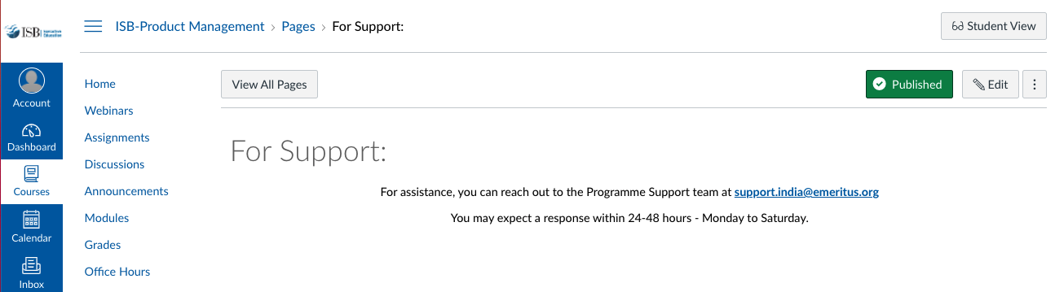
GETTING HELP
Notes:
And for content or assignment related material CLICK
You can reach out to your programme leader via an Inbox email for help. CLICK
Then for support for Canvas and other technical items contact support. This generally includes grading and associated scheduling and requests. When you click the Support tab it takes you to this page. Note that you are asked to send an email to programme.support@eruditus.com. For those of you who may not be in India, note the spelling of program.

Slide 6
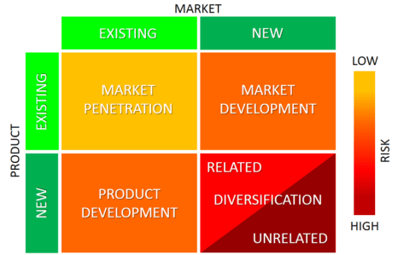
MODULE REVIEW – ANSOFF MATRIX
Notes:
Growing a business is the process of improving some measure of a company’s success. A business can grow in terms of employees, customer base, international coverage, profits, but growth is most often determined in terms of revenues. There are different ways of growing a business.
Igor Ansoff identified four strategies for growth and summarized them in the so called Ansoff Matrix. The Ansoff Matrix (also known as the Product/Market Expansion Grid) allows managers to quickly summarize these potential growth strategies and compare them to the risk associated with each one. The idea is that each time you move into a new quadrant (horizontally or vertically), risk increases.

Slide 7
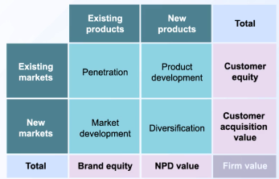
MODULE REVIEW – ANSOFF MATRIX EXPANDED
Notes:
Professor Raj added the dimension of “Firm Value” with some associated definitions.
Adding the dimension of firm value, which included Customer Equity, Customer Acquisition Value, Brand Equity and New Product Development (NPD) Value.
Also consider forward and backward integration . . . For example, Tesla owning their own car stores.
I will not cover the case studies, they are really for your background to discuss and perhaps make comments in the discussion topics. Let’s review the graded assignment, 1.2.

Slide 8
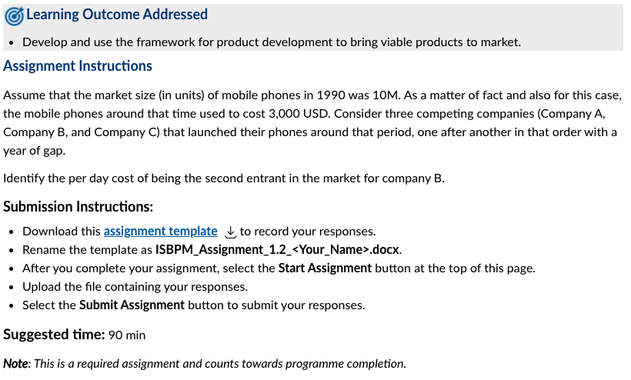
ASSIGNMENT DISCUSSION
Notes:
To help you get used to the assignments, let’s focus for a moment on the submission instructions:
CLICK
Download this assignment template Download assignment templateto record your responses.
Rename the template as ISBPM_Assignment_1.2_<Your_Name>.docx.
After you complete your assignment, select the Start Assignment button at the top of this page.
Upload the file containing your responses.
Select the Submit Assignment button to submit your responses.
And CLICK
The suggested amount of time it should take you is about 90 minutes.
Now for the actual assignment.

Slide 9
ASSIGNMENT DISCUSSION
Background - Assume that the market size (in units) of mobile phones in 1990 was 10M. As a matter of fact and also for this case, the mobile phones around that time used to cost 3,000 USD. Consider three competing companies (Company A, Company B, and Company C) that launched their phones around that period, one after another in that order with a year of gap.
Problem - Identify the per day cost of being the second entrant in the market for company B.
Notes:
Let’s take a look at Assignment 1.2. Use the Chat Box to answer and comment CLICK
Background - Assume that the market size (in units) of mobile phones in 1990 was 10M. As a matter of fact and also for this case, the mobile phones around that time used to cost 3,000 USD. Consider three competing companies (Company A, Company B, and Company C) that launched their phones around that period, one after another in that order with a year of gap.
CLICK
Problem - Identify the per day cost of being the second entrant in the market for company B.
Discuss for a bit and determine when to go to the next slide which lays out the math . . .
Missing components, the Total Addressable market is 10M, what percent does the first 3 entrants get? The problem solution assumes 60%, which aligns with the video, though it may not always.
Additionally, the “per day cost” is in terms of revenue, not profit. The video it is for daily profit.
Let’s now review the math from the lectures

Slide 10
ASSIGNMENT DISCUSSION
The Total Available Market is 5M units.
The first 3 entrants would get 60% of the Total Available Market (TAM).
That is 5M units * 60% = 3M units
What is the "cost" of the delay of the second entrant coming to market.
The first entrant would get X of the market, the second entrant would get 0.6 X of the third entrant would get 0.36 (0.6*0.6) X of the market.
This translates to roughly 50%, 30%, 20% of the 3M units for the first, second and third market entrants.
Use the contribution margin amount of $15/unit in order to calculate the cost of delay in going to market
Calculating the difference between first and second market entrants you get (1.5M - 900K) * $15 = $9M
Use a year as the timing of the second entrant to show what the delay costs per day.
Calculating the cost of delay per day as $9M / 365 which is roughly $25K per day
Notes:
In video 8 Professor Raj walks us through some high level calculations on the cost being late to market. Let’s walk through some of the assumptions and the associated math:
CLICK
The Total Available Market is 5M units.
CLICK
The first 3 entrants would get 60% of the Total Available Market (TAM).
That is 5M units * 60% = 3M units
CLICK
What is the "cost" of the delay of the second entrant coming to market.
The first entrant would get X of the market, the second entrant would get 0.6 X of the third entrant would get 0.36 (0.6*0.6) X of the market.
This translates to roughly 50%, 30%, 20% of the 3M units for the first, second and third market entrants.
CLICK
Use the contribution margin amount of $15/unit in order to calculate the cost of delay in going to market
Calculating the difference between first and second market entrants you get (1.5M - 900K) * $15 = $9M CLICK
Use a year as the timing of the second entrant to show what the delay costs per day.
Calculating the cost of delay per day as $9M / 365 which is roughly $25K per day
CLICK

Slide 11


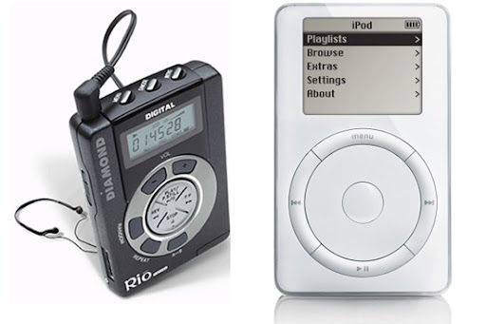
ASSIGNMENT DISCUSSION
Notes:
While it is important to understand the first mover advantage and its impact, it is also important to get the product and its associated business model right. Here are a few products where the first mover did not win the long term product space.
CLICK
VHS vs BetaMax – this is a great example of an Open vs Closed technology system. At the time everyone agreed that the Sony Betamax technology was better then VHS. However, the Betamax licensing terms were too onerous. The other video tape manufacturers turned to the VHS format for their products. This encouraged the content providers, who are part of the product value ecosystem, to put their weight behind the VHS format. New titles came out on VHS first and sometimes never on the Betamax format.
In this case, the VHS technology was “good enough” and it was the broader ecosystem that drove the market.
CLICK
iPod vs Diamond Rio player – Another example is Apple’s iPod. Before the iPod there were other MP3 players like the Diamond Rio Player. To use these devices you had to rip a CD with an application like SoundJam and then load the resulting MP3 onto the device. The amount that the devices could store was limited to roughly a “record album or two”, about 20 songs. And you had to piece together the broader solution yourself.
Apple did a number of things with the release of the iPod. They saw a new 2.5” hard drive from Toshiba. They committed to Toshiba that they would buy all of the devices they could produce for a year for the exclusive rights to the drives during that year. Additionally, they bought the company SoundJam, which became iTunes. To further help provide a solution they set up a relationship with the record labels to sell their music digitally via the iTunes store, 99 cents a song. Building out this ecosystem made it dramatically easier for people to use the iPod in a meaningful way.
Finally, Apple did some great branding by playing up a feature that differentiated the iPod, the disk drive. Only they put it in terms of what mattered to the consumer, “1000 Songs in your pocket”.
CLICK
The history of the search engine was similar, first there was Yahoo, though some claim that was just an organized way to find things. Excite, Alta Vista and Ask Jeeves all followed until in 1997 there was Google. While many point to the backlink technology as the critical innovation by Google I would point to something a bit different, their business model. In general, the goal of the previous search engines was to attract traffic. Once on the site the objective was to keep them there so they could “monetize the eyeballs”. What Google did, though they did not invent it, was monetize search in a completely different way, by sending the visitors to the “most relevant sites”.
They had a big focus on relevancy of search and their algorithm. The did was a few things to monetize their efforts, they separated the advertising from the natural organic search. Further, they developed an algorithm that also helped display the most relevant ads. This was quite new at the time since most content providers, meaning newspapers, would separate editorial from advertising. Google enabled advertising of relevant ads in close proximity to the content.
Okay, now for some additional resources . . .

Slide 12
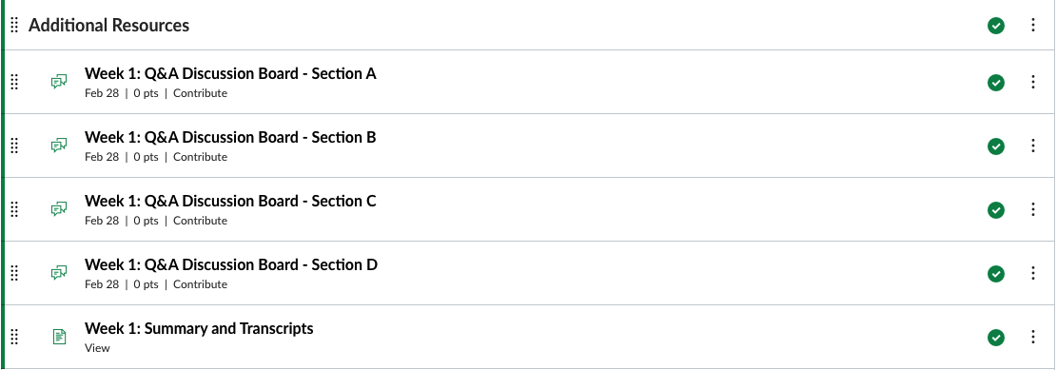
QUESTIONS FROM DISCUSSION BOARDS AND IN-BOX
Can I get a summary of the lectures and slides before watching the lectures?
Notes:
Yes, at the end of each module by after the weekly discussions there is a section titled:
Summary and transcripts
CLICK
If you open that there are two items
Summary and Video Transcripts. These are, Summary are the slides used by the professors in their lectures. Transcripts is a transcript of the audio from the lectures.

Slide 13




Open Questions – Tools Training
Module/Week 2
Module/Week 4
Module/Week 7
Module/Week 11
Notes:
Last week there was a question about the tools that would be covered in the course. The following tools are optional with content included in certain weeks of the program..
CLICK
Jira – Module 2
CLICK
Balsamiq – Module 4
CLICK
Google Analytics – Module 7
CLICK
Mixpanel – Module 11
Optional/Ungraded Course(s) 2.5: Jira Tutorials
Ungraded Course(s) 4.5: Balsamiq Rapid Wireframing Course
Optional/Ungraded Certification(s) 7.3: Google Analytics Certification
Optional/Ungraded Course(s) 11.2: Introduction to Mixpanel

Slide 14

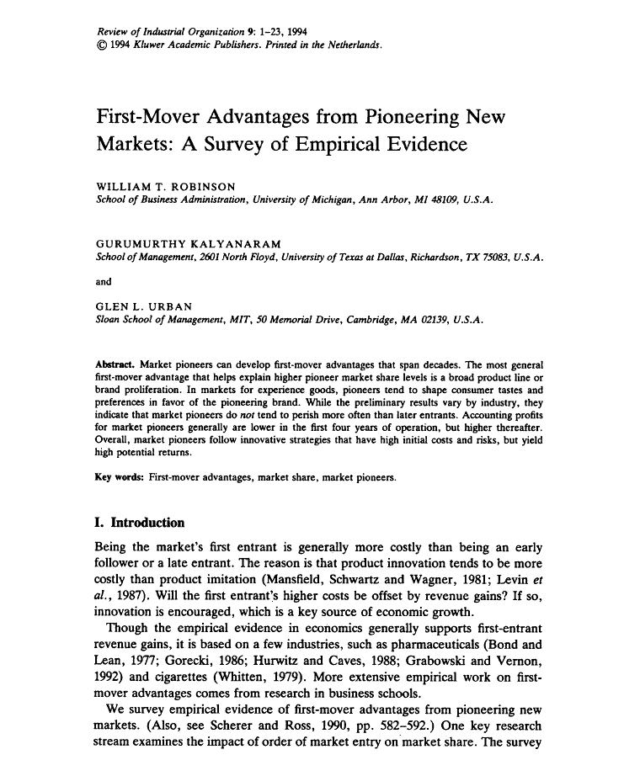
ADDITIONAL RESOURCES
Notes:
In our last office hours session some of you asked for additional resources. CLICK
Let me start with a book mentioned by professor Raj in video 4A, the Rule of Three by Jagdish Sheth and Rajendra Sisodia.
https://amzn.to/3xX1HUA
Professor Raj referenced the research article by WILLIAM T. ROBINSON, GURUMURTHY KALYANARAM and GLEN L. URBAN, First-mover advantages from pioneering new markets: A survey of empirical evidence. This article came out in February of 1994.
Market pioneers can develop first-mover advantages that span decades. The most general first-mover advantage that helps explain higher pioneer market share levels is a broad product line or brand proliferation. While the preliminary results vary by industry, they indicate that market pioneers donot tend to perish more often than later entrants. Accounting profits for market pioneers generally are lower in the first four years of operation, but higher thereafter. Overall, market pioneers follow innovative strategies that have high initial costs and risks, but yield high potential returns.
I would just emphasize the risks for a moment. Consider the huge risk Apple made in committing to all the 2.5” disk drives that Toshiba could produce. That is a huge expense. Often, fortune favors the bold.
https://link.springer.com/article/10.1007/BF01024216

Slide 15
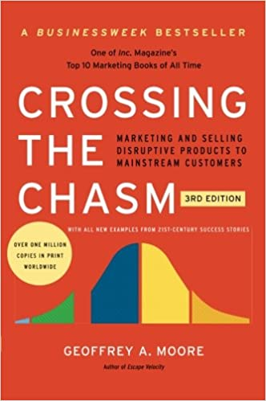

ADDITIONAL RESOURCES
Notes:
When asked last week what books we like a couple of us mentioned, CLICK
Crossing the Chasm by Geoffrey Moore. Professor Raj referenced this book and the associated technology adoption curve a few times in the lectures this week.
What he shows shows that is the Technology Adoption Life Cycle—which begins with innovators and moves to early adopters, early majority, late majority, and laggards—there is a vast chasm between the early adopters and the early majority. While early adopters are willing to sacrifice for the advantage of being first, the early majority waits until they know that the technology actually offers improvements in productivity. The challenge for innovators and marketers is to narrow this chasm and ultimately accelerate adoption across every segment.
Technology has the shelf life of a banana and a few other variants. CLICK
I worked for Sun Microsystems and it was a phrase often used by our CEO Scott McNealy. Links to these are included in the office hours slides. In next week’s discussion topic I will also include the links.
https://www.crn.com/news/channel-programs/18838364/crn-interview-scott-mcnealy-sun.htm
https://www.cnbc.com/video/2014/02/07/technology-has-the-shelf-life-of-a-banana-mcnealy.html
Now

Slide 16
NEXT WEEK - Product Development Process
Program learning outcomes addressed:
Develop the right mindset to bring viable products or services to market.
Analyse strategies and frameworks for developing & marketing a new product.
By the end of this week, you will be able to:
Discuss the role of design thinking in building an effective product portfolio.
Explain the importance of understanding customer needs in an efficient/effective product development process.
Explain how customer value dimensions influence the final product portfolio.
Understand the role of marketing in the product development process
Understand the concept of customer value and the crucial role it plays in developing superior solutions.
Create superior value for customers.
Notes:
In it we will cover:
CLICK
Program learning outcomes addressed this week:
Develop the right mindset to bring viable products (or services) to market. CLICK
Analyse strategies and frameworks for developing and marketing a new product. CLICK
By the end of this week, you will be able to:
Discuss the role of design thinking in building an effective product portfolio. CLICK
Explain the importance of understanding customer needs in an efficient/effective product development process. CLICK
Explain how customer value dimensions positively influence the final product portfolio. CLICK
Understand the role of marketing in the product development process, understand the concept of customer value and the crucial role it plays in developing superior solutions. CLICK
Create superior value for customers. CLICK

Slide 17

Over to you!

